Slide 1


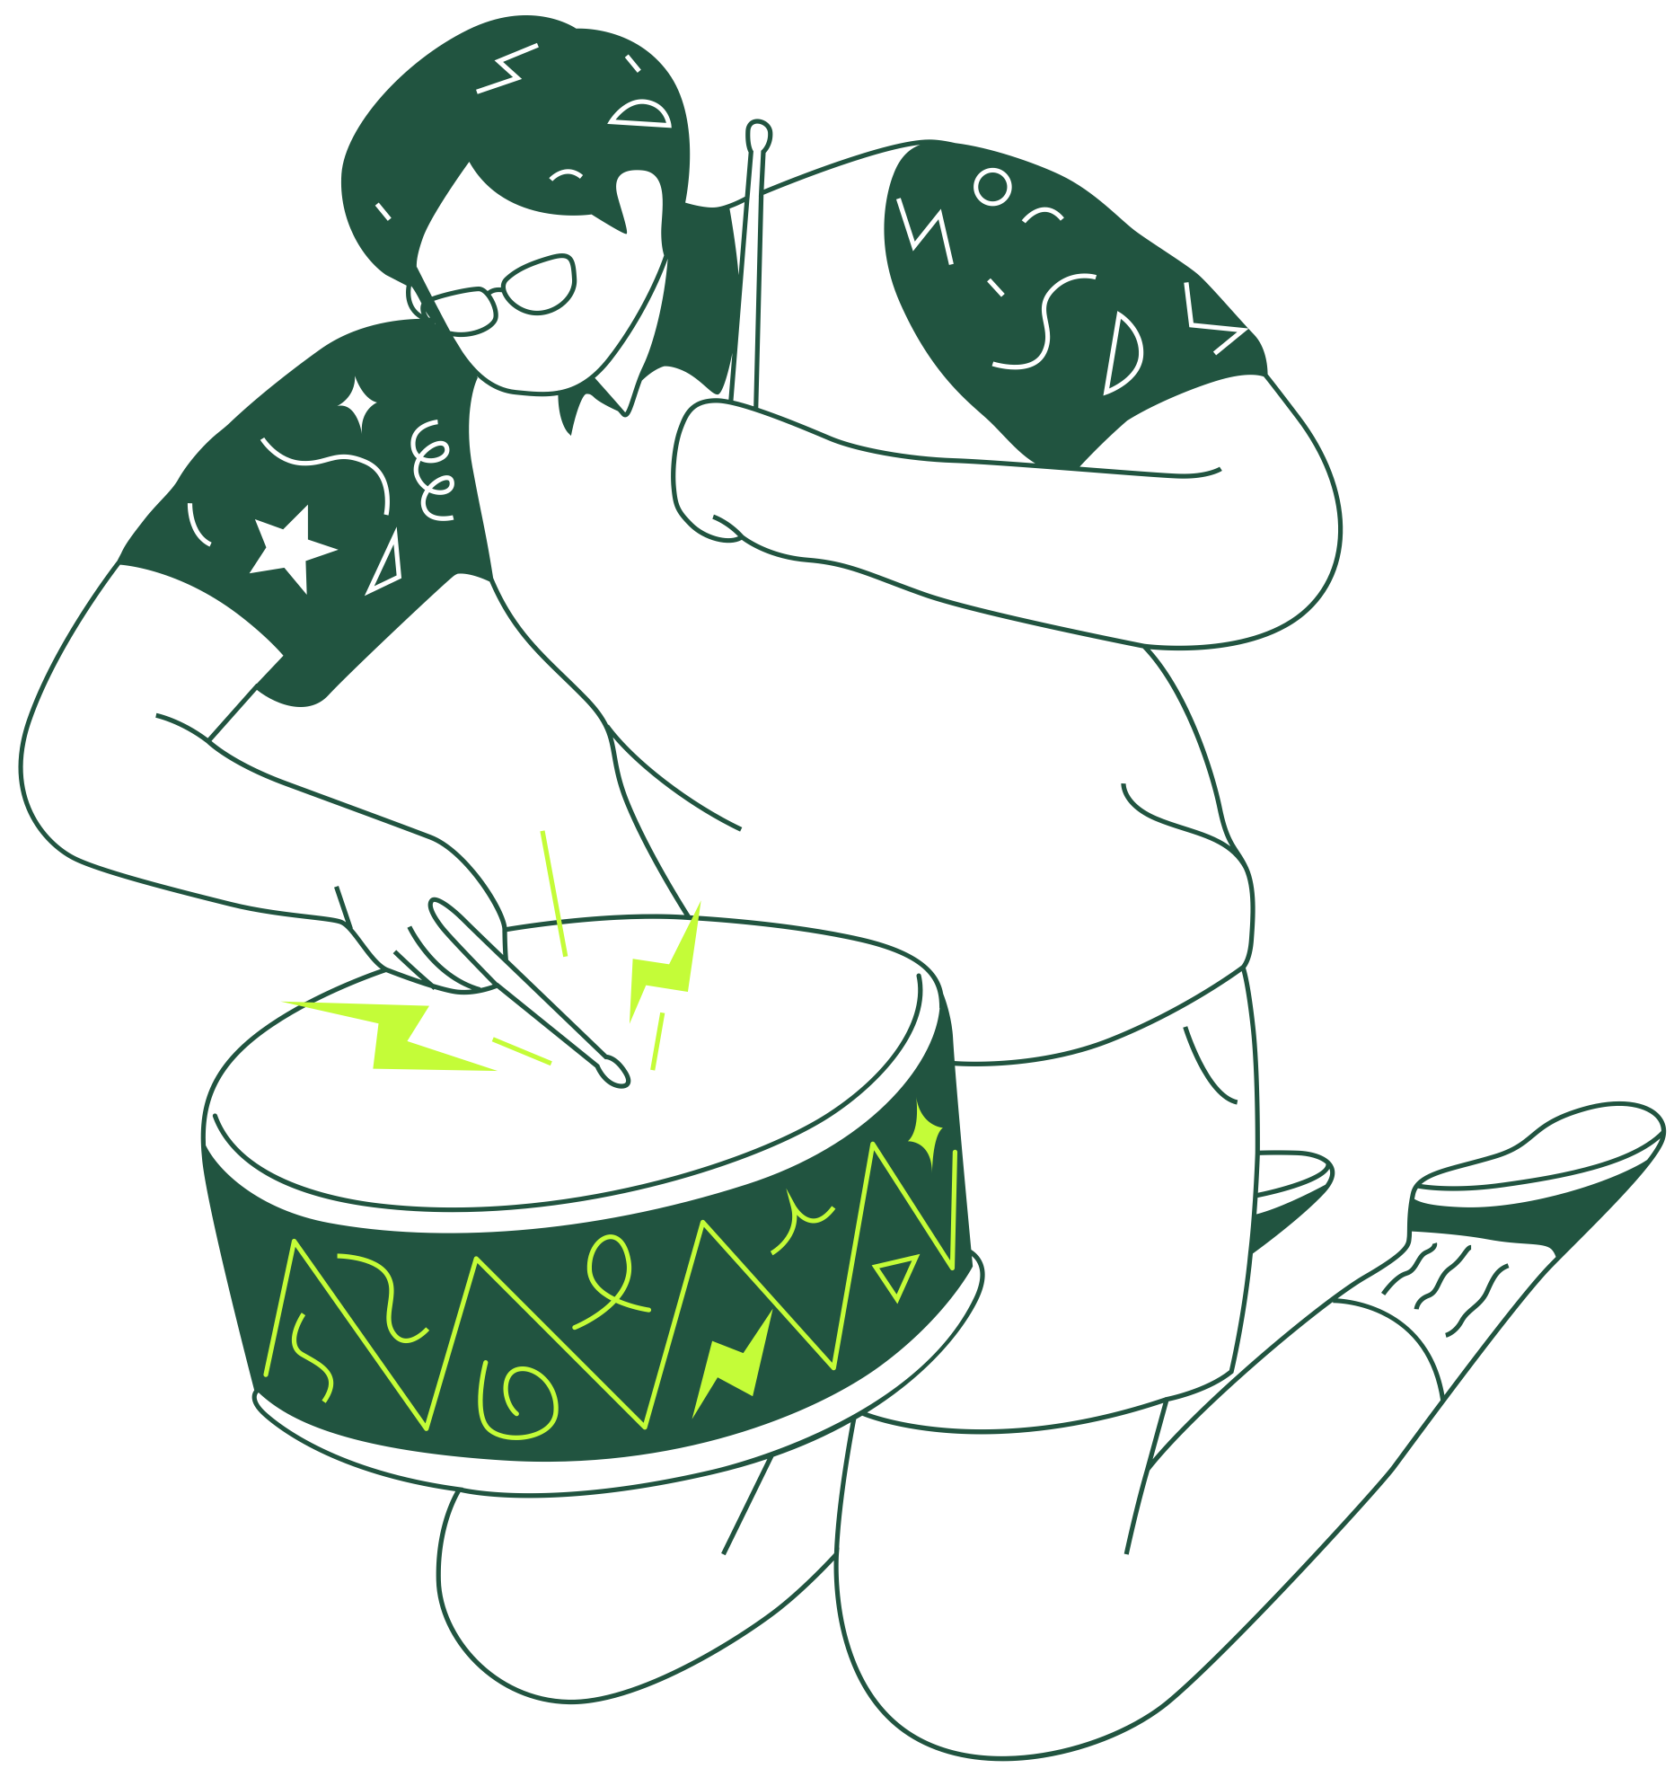



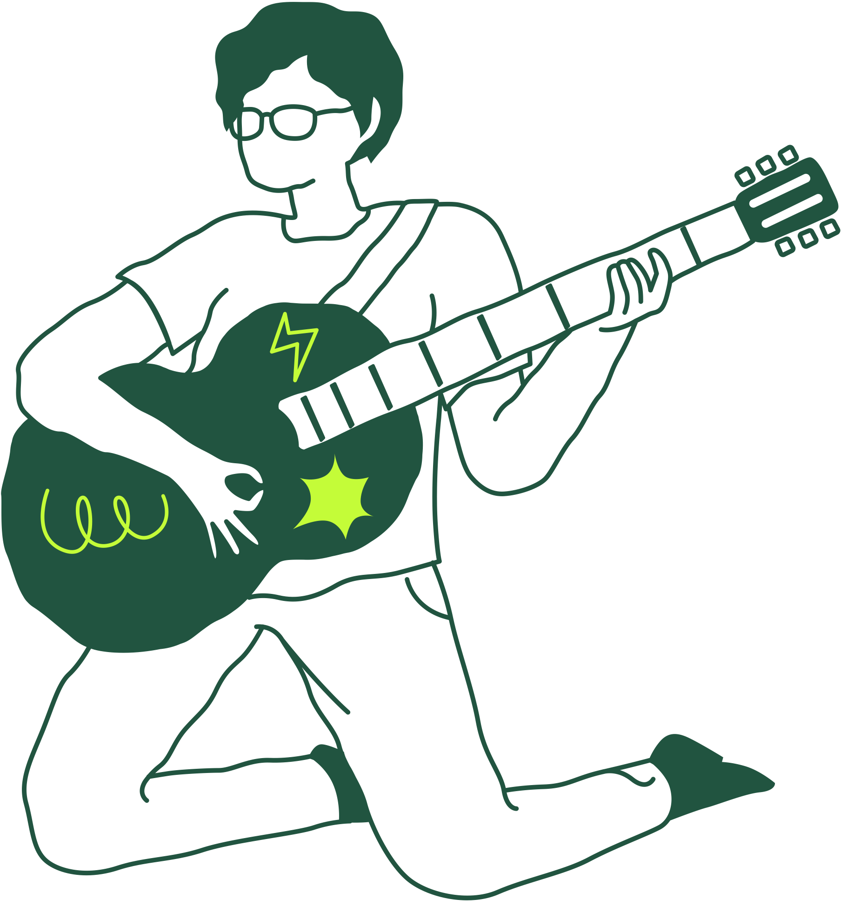
EMOTIVERSE Enhancing Mood & Productivity Through Music & Social Interaction
Presented By: Team Caffeine
1

Slide 2







Submitted By
Name: Tamanna Islam
Department: Computer Science and Engineering
ID: 2021-3-60-125
Name: B. M. Shahria Alam
Department: Computer Science and Engineering
ID: 2021-3-60-016
Name: Golam Kibria
Department: Computer Science and Engineering
ID: 2021-3-60-215
Name: Shekh Maruf
Department: Computer Science and Engineering
ID: 2021-3-60-157
3

Slide 3

Yasin Sazid Lecturer Department of Computer Science & Engineering East West University
Submitted To
2

Slide 4
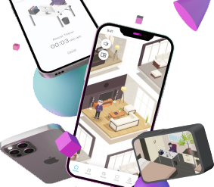
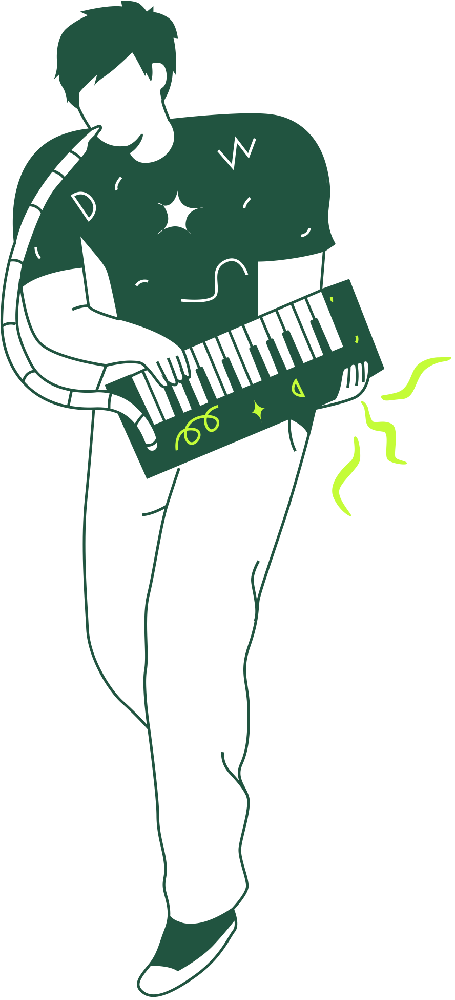
What is Emotiverse?
A metaverse-like application designed to enhance mood and productivity.
Uses personalized music, social interaction and mood tracking.
4

Slide 5
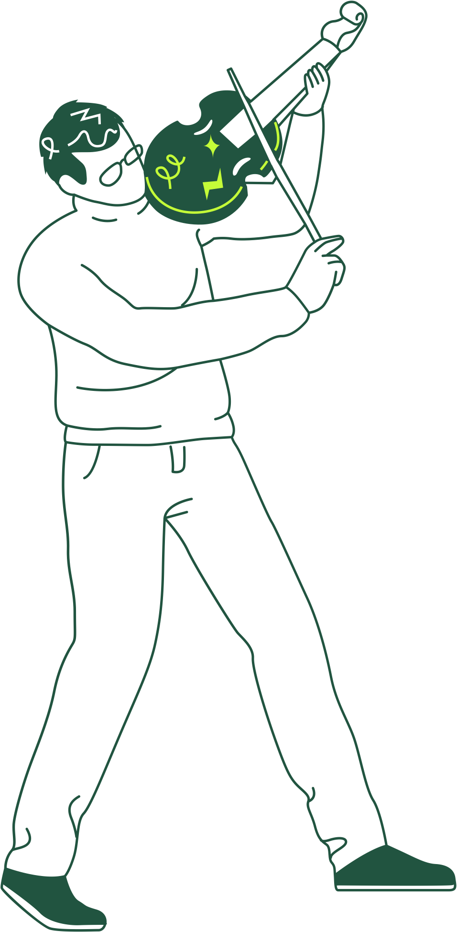
WHY DO WE NEED EMOTIVERSE?
`
📌 Issues Faced by Students
📌 Stress & anxiety impact mental health
📌 Lack of personalized tools to improve mood & focus
📌 Students often use music for concentration, but
current solutions lack social & immersive features
5

Slide 6


HOW EMOTIVERSE SOLVES THESE ISSUES!
🎵 Personalized Music – Tailored
playlists to enhance emotions.
📊 Mood Tracking – Helps students
reflect & manage emotions.
🧑‍🤝‍🧑 Social Interaction – Connects users
through avatars & shared experiences
🔊 Immersive Environment – Bluetooth
speaker & animations enhance focus.
6

Slide 7

Introduction
USER RESEARCH & FINDINGS
Here’s what you’ll find in this Slidesgo template:
A slide structure based on a Thesis presentation, which you can easily adapt to your needs. For more info on how to edit the template, please visit Slidesgo School or read our FAQs.
An assortment of graphic resources that are suitable for use in the presentation can be found in the alternative resources slide.
A thanks slide, which you must keep so that proper credits for our design are given.
A resources slide, where you’ll find links to all the elements used in the template.
Instructions for use.
Final slides with:
The fonts and colors used in the template.
A selection of illustrations. You can also customize and animate them as you wish with the online editor. Visit Storyset to find more.
More infographic resources, whose size and color can be edited.
Sets of customizable icons of the following themes: general, business, avatar, creative process, education, help & support, medical, nature, performing arts, SEO & marketing, and teamwork.
You can delete this slide when you’re done editing the presentation
📌 Students prefer immersive, distraction-free experiences
📌 Need for better focus-enhancing environments
📌 Interest in music-sharing with friends for social bonding
7

Slide 8
HOW EMOTIVERSE WORKS?
User Experience Walk-through
📌 User logs in & selects mood
📌 AI generates personalized playlist
📌 User interacts with avatars & community
8

Slide 9

WHY EMOTIVERSE IS MATTERS ?
🎯 Emotiverse is a revolutionary way to enhance
productivity & mood.
😊 It combines music, social interaction & mood tracking
effectively.
🤝 With future improvements, it has huge potential for
student well-being
9

Slide 10
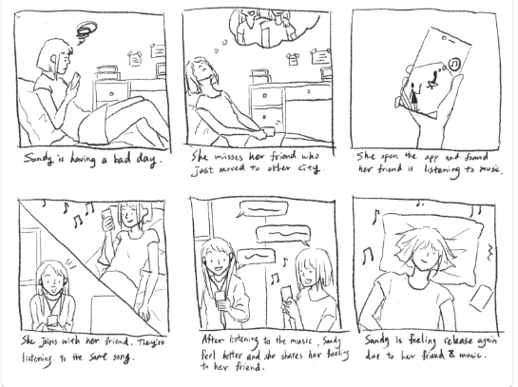
10
Storyboards of Sandy using Emotiverse in various ways

Slide 11
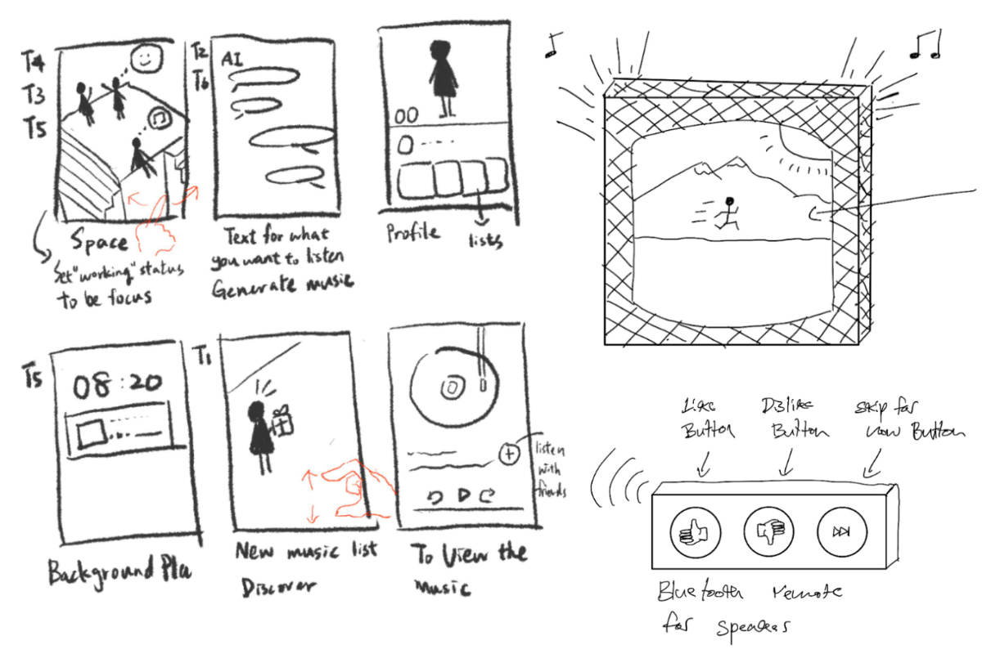
INITIAL SKETCHES DESIGN OF EMOTIVERSE
11

Slide 12
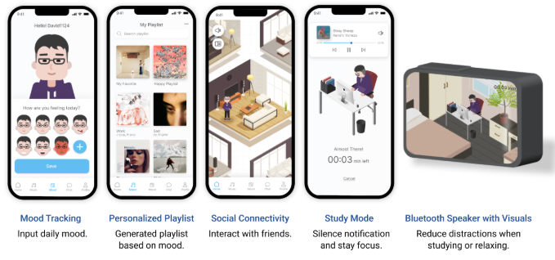
OVERALL FINAL DESIGN OF EMOTIVERSE
12

Slide 13
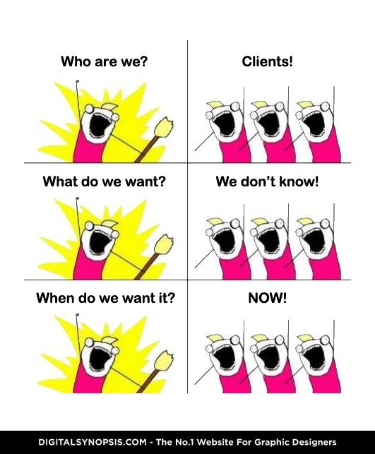
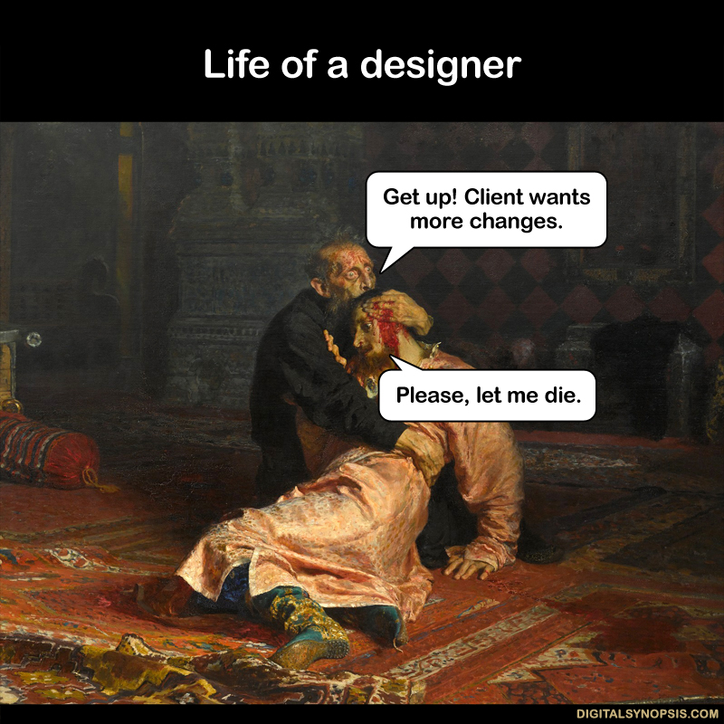
BUT...
13

Slide 14
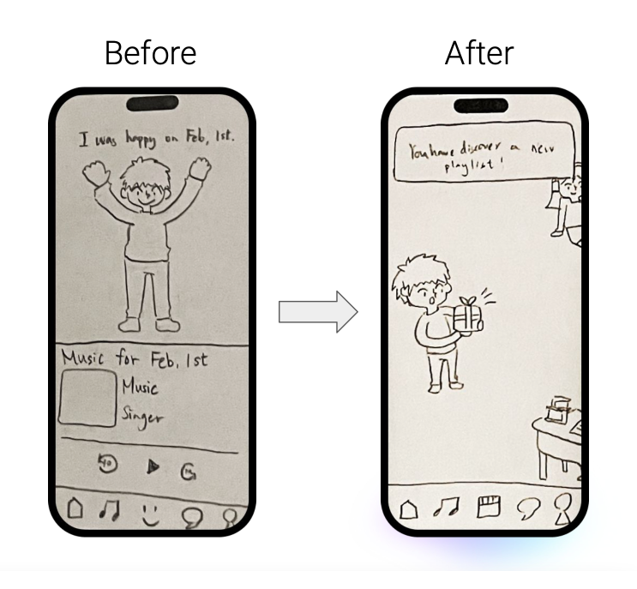
ADDRESSING THE CONFUSION
🎵 Playlist Location Issue: Initially
placed on the mood tracking screen, it
wasn't very clear.
✅ Solution: Moved to the music screen
with a homepage shortcut.
🔄 Navigation Fix: Redesigned layout to
replace inconvenient swipe navigation.
🏷️ Clarity: All buttons are now labeled
for better usability.
Addressing the confusion of accessing the recommended playlist
14

Slide 15
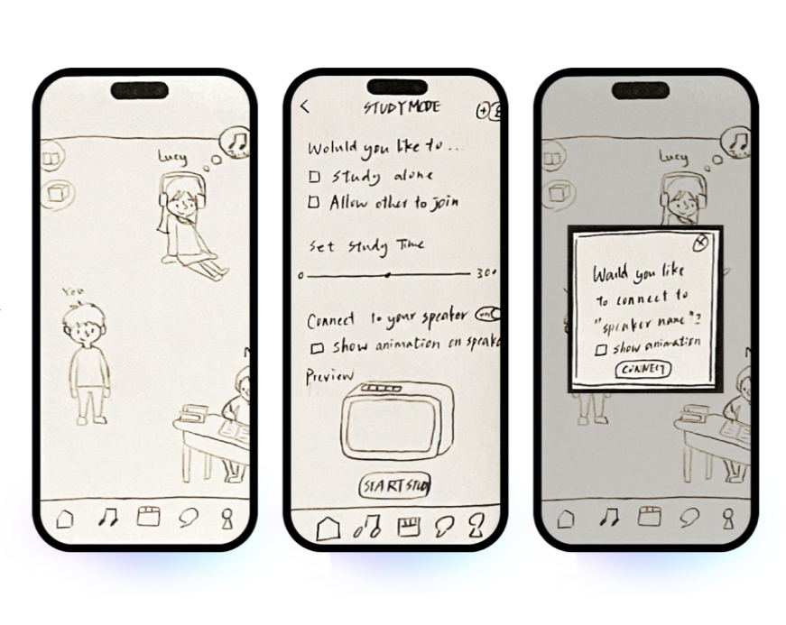
ENHANCING USER CONTROL AND FLEXIBILITY
💬 User Feedback: Participants wanted
more control over entering speaker
and study mode separately.
⚠️ Issue: Both modes were combined on
the same screen, limiting flexibility.
🔄 Solution: Separated the connection
process into different screens with
shortcuts to switch between them.
🏠 Home Screen Shortcut: Added quick
access to connect to the speaker or
enter study mode.
The process of connecting to speaker.
15

Slide 16
ENHANCING USER CONTROL AND FLEXIBILITY
🎨 Speaker Connection Issue:
Customizing the background or
animation every time was distracting.
⚙️ Fix: Added an option to set a default
background and animation in settings,
removing the prompt during connection.
🚀 Result: Improved user control,
flexibility, and a smoother experience.
The process of connecting to speaker.
16

Slide 17
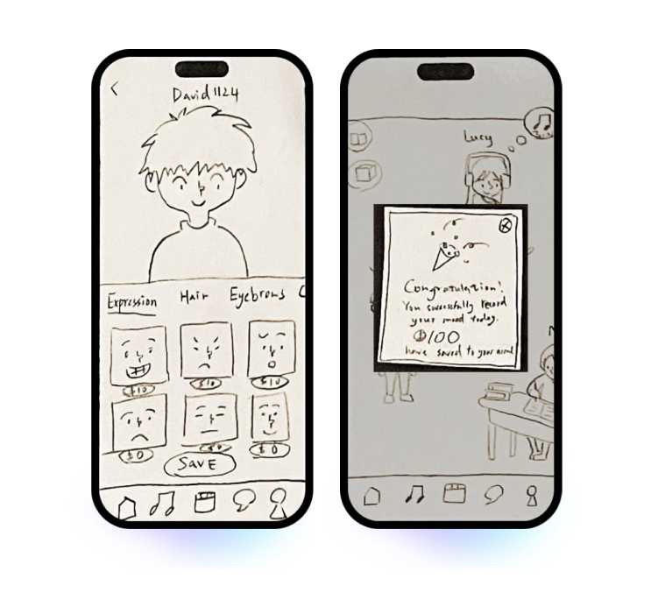
ADDING A REWARDS SYSTEM
💡 Key Insight: Incentives are crucial
for user engagement.
🗣️ Feedback: Users wanted motivation
to continue using the app.
🎁 Solution: Introduced a currency
based rewards system.
💰 Earning Rewards: Users earn
currency by inputting mood or
studying for a set time.
Incentives that can be used for customization
17

Slide 18
ADDING A REWARDS SYSTEM
🏠 Spending Rewards: Currency can
be used to buy avatars and room
customizations.
🚀 Result: Increased engagement and
enjoyment of the app.
Incentives that can be used for customization
18

Slide 19
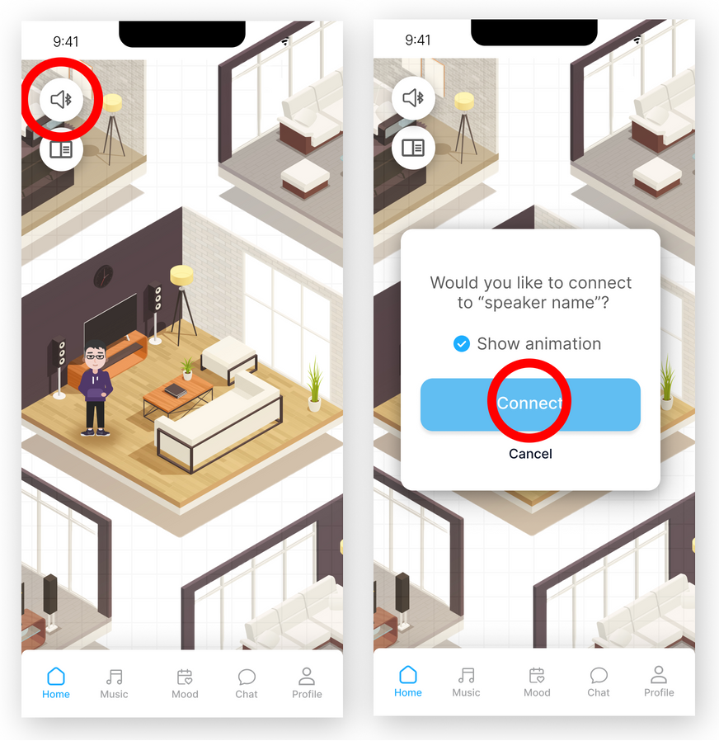
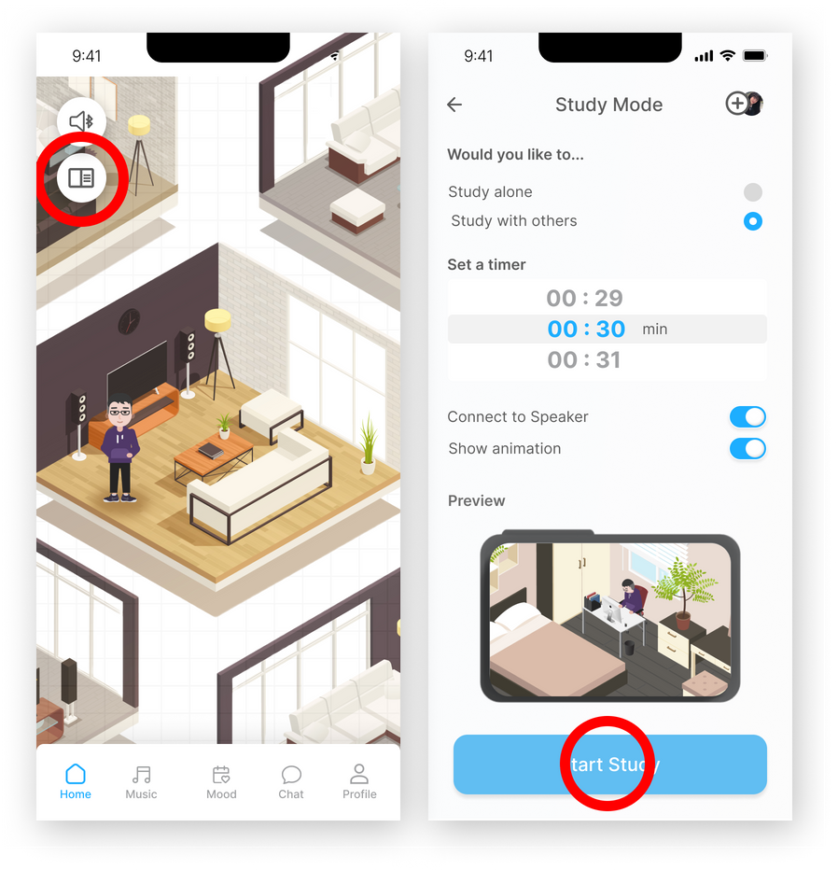
FEATURES ADDED AFTER FEEDBACK
19

Slide 20
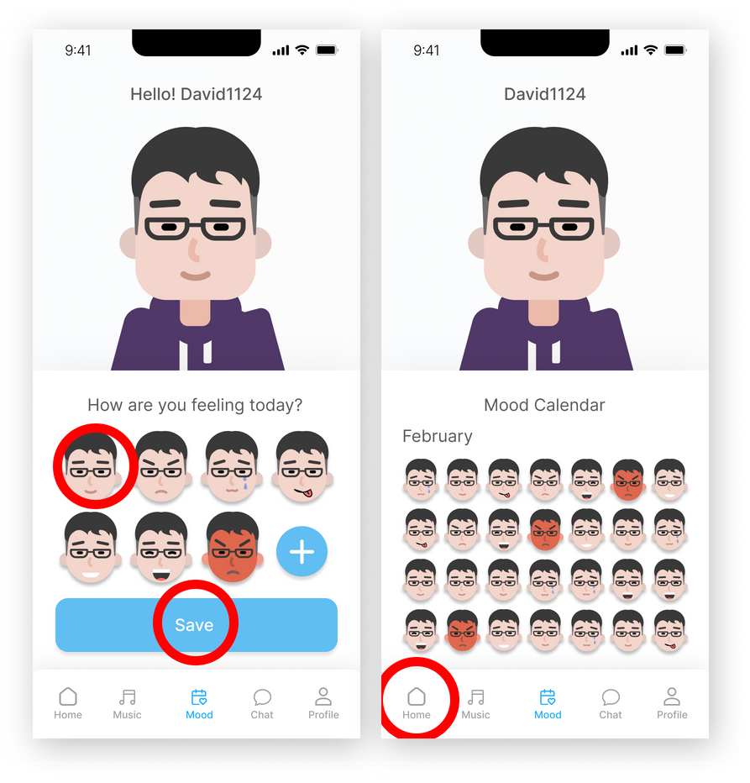
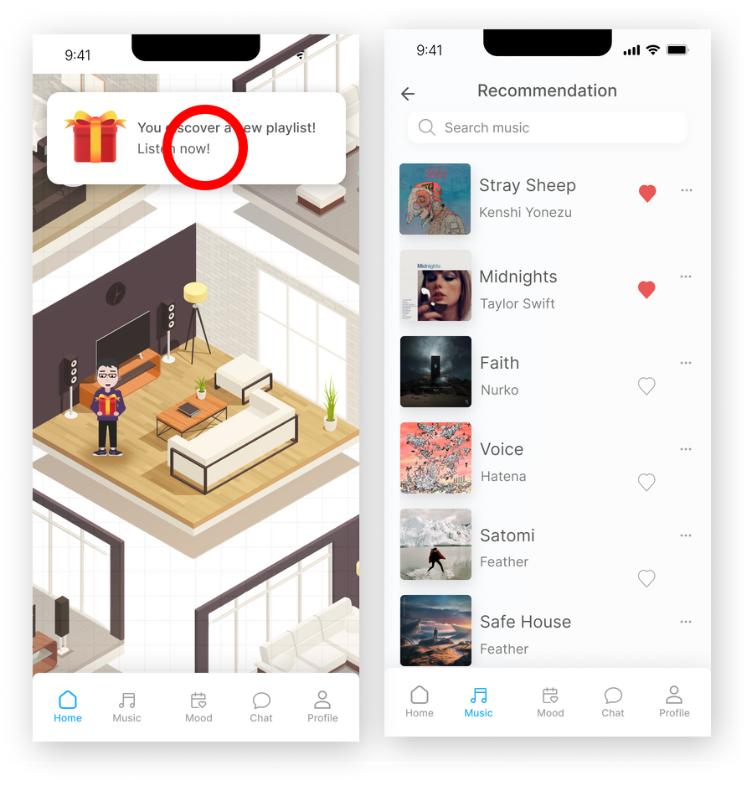
FEATURES ADDED AFTER FEEDBACK
20

Slide 21
Thank You!
21

